Slide 1

Psychological Disorders
Chapter 14

Slide 2
Chapter 14 Learning Objective Menu
LO 14.1 Early explanations of mental illness
LO 14.2 Defining abnormal behavior
LO 14.3 How psychological disorders relate to brain and body
LO 14.4 How different viewpoints explain psychological disorders
LO 14.5 Abnormality in other cultures
LO 14.6 How psychologists diagnose disorders
LO 14.7 Types of psychological disorders
LO 14.8 Types and symptoms of anxiety disorders
LO 14.9 Causes of anxiety disorders
LO 14.10 Types of somatoform disorders
LO 14.11 Causes of somatoform disorders
LO 14.12 Types of dissociative disorders
LO 14.13 How dissociative disorders develop
LO 14.14 Controversy surrounding “Sybil”
LO 14.15 Types of mood disorders
LO 14.16 Causes of mood disorders
LO 14.17 Main symptoms of schizophrenia
LO 14.18 Types of schizophrenia
LO 14.19 Causes of schizophrenia
LO 14.20 Types of personality disorders
LO 14.21 Causes of personality disorders
LO 14.21 Seasonal affective disorder

Slide 3
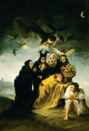
Early Explanations of Mental Illness
LO 14.1 Early explanations of mental illness
In ancient times holes were cut in an ill person’s head to let out evil spirits in a process called trepanning.
Hippocrates believed that mental illness came from an imbalance in the body’s four humors.
In the Middle Ages, the mentally ill were labeled as witches.
Menu

Slide 4
Definitions of Abnormality
LO 14.2 Defining abnormal behavior
Psychopathology - the study of abnormal behavior.
Psychological disorders - any pattern of behavior that causes people significant distress, causes them to harm others, or harms their ability to function in daily life.
Menu

Slide 5
Definitions of Abnormality
LO 14.2 Defining abnormal behavior
Definitions of Abnormality:
  Statistically rare
  Deviant from social norms
    Situational context - the social or environmental setting of a person’s behavior.
  Subjective discomfort - emotional distress or emotional pain.
  Maladaptive - anything that does not allow a person to function within or adapt to the stresses and everyday demands of life.
Menu

Slide 6
Biology and Psychopathology
LO 14.3 How psychological disorders relate to brain and body
Biological model – model of explaining behavior as caused by biological changes in the chemical, structural, or genetic systems of the body.
Menu

Slide 7
Psychological Viewpoints of Psychopathology
LO 14.4 How different viewpoints explain psychological disorders
Psychoanalytic theorists - assume that abnormal behavior stems from repressed conflicts and urges that are fighting to become conscious.
Behaviorists - see abnormal behavior as learned.
Cognitive theorists - see abnormal behavior as coming from irrational beliefs and illogical patterns of thought.
Menu

Slide 8
Culture and Psychopathology
LO 14.5 Abnormality in other cultures
Cultural relativity - the need to consider the unique characteristics of the culture in which behavior takes place.
Culture-bound syndromes – disorders found only in particular cultures.
Menu

Slide 9
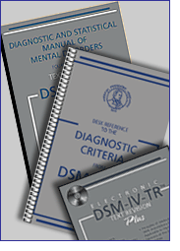
DSM-IV-TR
LO 14.6 How psychologists diagnose disorders
Diagnostic and Statistical Manual, Version IV, Text Revision is a manual of psychological disorders and their symptoms.
Menu

Slide 10
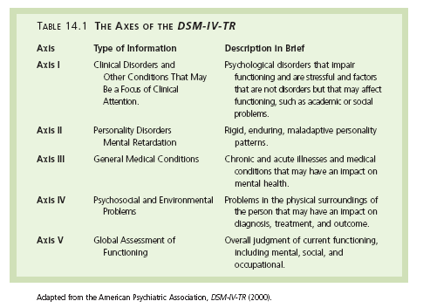
LO 14.6 How psychologists diagnose disorders
Menu

Slide 11
Types of Disorders
LO 14.7 Types of psychological disorders
There are five axes in the DSM-IV-TR, which include clinical disorders, personality disorders, general medical conditions, psychosocial and environmental problems, and a global assessment of functioning.
Over one-fifth of all adults over age 18 suffer from a mental disorder in any given year.
Major depression is one of the most common psychological disorders worldwide.
Menu

Slide 12
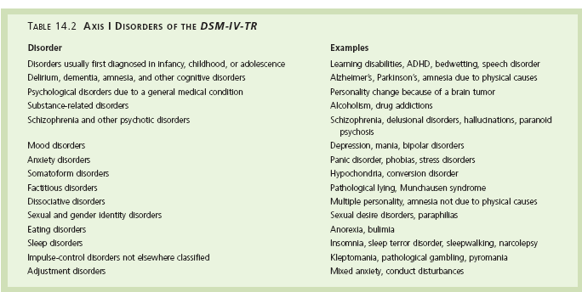
LO 14.7 Types of psychological disorders
Menu

Slide 13
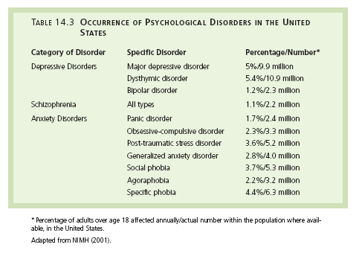
LO 14.7 Types of psychological disorders
Menu

Slide 14
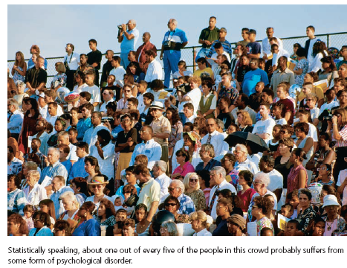
LO 14.7 Types of psychological disorders
Menu

Slide 15
Anxiety Disorders
LO 14.8 Types and symptoms of anxiety disorders
Anxiety disorders - disorders in which the main symptom is excessive or unrealistic anxiety and fearfulness.
  Free-floating anxiety - anxiety that is unrelated to any realistic, known source.
Phobia - an irrational, persistent fear of an object, situation, or social activity.
  Social phobia - fear of interacting with others or being in social situations that might lead to a negative evaluation.
Menu

Slide 16

Anxiety Disorders
LO 14.8 Types and symptoms of anxiety disorders
  Specific phobia - fear of objects or specific situations or events.
    Claustrophobia - fear of being in a small, enclosed space.
    Acrophobia - fear of heights.
    Agoraphobia - fear of being in a place or situation from which escape is difficult or impossible.
Menu

Slide 17
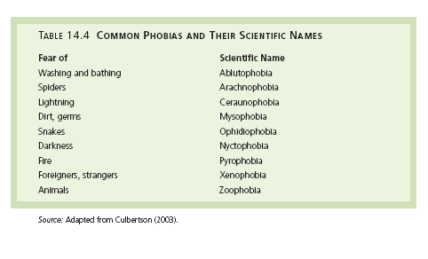
LO 14.8 Types and symptoms of anxiety disorders
Menu

Slide 18
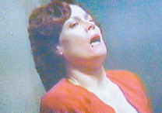
Anxiety Disorders
LO 14.8 Types and symptoms of anxiety disorders
Obsessive-compulsive disorder – disorder in which intruding, recurring thoughts or obsessions create anxiety that is relieved by performing a repetitive, ritualistic behavior (compulsion).
Panic disorder – disorder in which panic attacks occur frequently enough to cause the person difficulty in adjusting to daily life.
  Panic attack - sudden onset of intense panic in which multiple physical symptoms of stress occur, often with feelings that one is dying.
Menu

Slide 19

LO 14.8 Types and symptoms of anxiety disorders
sweating
racing heart
chest pain
shortness of breath
dizziness
nausea
hot flashes/chills
trembling
terror
desire to escape
PANIC! PANIC! PANIC! PANIC!
Menu

Slide 20
Anxiety Disorders
LO 14.8 Types and symptoms of anxiety disorders
Panic disorder with agoraphobia - fear of leaving one’s familiar surroundings because one might have a panic attack in public.
Generalized anxiety disorder - disorder in which a person has feelings of dread and impending doom along with physical symptoms of stress, which lasts six months or more.
Menu

Slide 21
Causes of Anxiety Disorders
LO 14.9 Causes of anxiety disorders
Psychoanalytic explanations point to repressed urges and desires that are trying to come into conscious, creating anxiety that is controlled by the abnormal behavior.
Behaviorists state that disordered behavior is learned through both positive and negative reinforcement.
Menu

Slide 22
Causes of Anxiety Disorders
LO 14.9 Causes of anxiety disorders
Cognitive psychologists believe that excessive anxiety comes from illogical, irrational thought processes.
  Magnification - the tendency to interpret situations as far more dangerous, harmful, or important than they actually are.
  All-or-nothing thinking - the tendency to believe that one’s performance must be perfect or the result will be a total failure.
  Overgeneralization - the tendency to interpret a single negative event as a never-ending pattern of defeat and failure.
  Minimization - the tendency to give little or no importance to one’s successes or positive events and traits.
Biological explanations of anxiety disorders include chemical imbalances in the nervous system, in particular serotonin and GABA systems.
Menu

Slide 23
Somatoform Disorders
LO 14.10 Types of somatoform disorders
Somatoform disorders - disorders that take the form of bodily illnesses and symptoms but for which there are no real physical disorders.
Psychosomatic disorder - disorder in which psychological stress causes a real physical disorder or illness.
Psychophysiological disorder - modern term for psychosomatic disorder.
Menu

Slide 24
Somatoform Disorders
LO 14.10 Types of somatoform disorders
Hypochondriasis - somatoform disorder in which the person is terrified of being sick and worries constantly, going to doctors repeatedly, and becoming preoccupied with every sensation of the body.
Somatization disorder - somatoform disorder in which the person dramatically complains of a specific symptom such as nausea, difficulty swallowing, or pain for which there is no real physical cause.
Conversion disorder – somatoform disorder in which the person experiences a specific symptom in the somatic nervous system’s functioning, such as paralysis, numbness, or blindness, for which there is no physical cause.
Menu

Slide 25
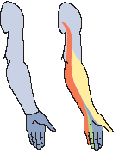
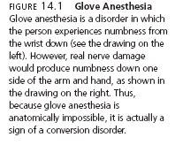
LO 14.10 Types of somatoform disorders
Menu

Slide 26
Causes of Somatoform Disorders
LO 14.11 Causes of somatoform disorders
Psychoanalytic explanations of somatoform disorders assume that anxiety is turned into a physical symptom.
Behavioral explanations point to the negative reinforcement experienced when the “ill” person escapes unpleasant situations such as combat.
Cognitive explanations assume that people magnify their physical symptoms and normal bodily changes into ailments out of irrational fear.
Menu

Slide 27
Dissociative Disorders
LO 14.12 Types of dissociative disorders
Dissociative disorders – disorders in which there is a break in conscious awareness, memory, the sense of identity, or some combination.
  Dissociative amnesia - loss of memory for personal information, either partial or complete.
  Dissociative fugue - traveling away from familiar surroundings with amnesia for the trip and possible amnesia for personal information.
Menu

Slide 28
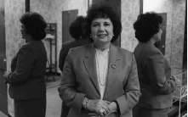
Dissociative Disorders
LO 14.12 Types of dissociative disorders
  Dissociative identity disorder - disorder occurring when a person seems to have two or more distinct personalities within one body.
  Depersonalization disorder – dissociative disorder in which a person feels detached and disconnected from themselves, their bodies, and their surroundings.
Menu

Slide 29
Development of Dissociative Disorders
LO 14.13 How dissociative disorders develop
Psychoanalytic explanations point to repression of memories, seeing dissociation as a defense mechanism against anxiety.
Cognitive and behavioral explanations see dissociative disorders as a kind of avoidance learning.
Biological explanations point to lower than normal activity levels in the areas responsible for body awareness in people with dissociative disorders.
Menu

Slide 30
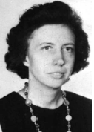

Sybil Controversy
LO 14.14 Controversy surrounding “Sybil”
There is taped evidence to suggest that the psychiatrist treating “Sybil,” the famous multiple personality case, may have suggested to “Sybil” that she view her emotions as separate personalities.
Menu

Slide 31
Mood Disorders
LO 14.15 Types of mood disorders
Affect – in psychology, an emotional reaction.
Mood disorders - disorders in which mood is severely disturbed.
  Dysthymia - a moderate depression that lasts for two years or more and is typically a reaction to some external stressor.
  Cyclothymia - disorder that consists of mood swings from moderate depression to hypomania and lasts two years or more.
Menu

Slide 32


LO 14.15 Types of mood disorders
Menu

Slide 33
Mood Disorders
LO 14.15 Types of mood disorders
  Major depression - severe depression that comes on suddenly and seems to have no external cause.
  Manic - having the quality of excessive excitement, energy, and elation or irritability.
  Bipolar disorder - severe mood swings between major depressive episodes and manic episodes.
Menu

Slide 34

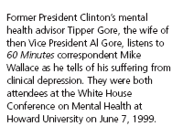
LO 14.15 Types of mood disorders
Menu

Slide 35


LO 14.15 Types of mood disorders
Menu

Slide 36
Causes of Mood Disorders
LO 14.16 Causes of mood disorders
Psychoanalytic theories see depression as anger at authority figures from childhood turned inward on the self.
Learning theories link depression to learned helplessness.
Cognitive theories see depression as the result of distorted, illogical thinking.
Biological explanations of mood disorders look at the function of serotonin, norepinephrine, and dopamine systems in the brain.
Menu

Slide 37
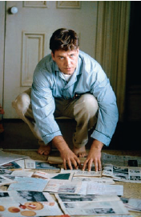

Schizophrenia
LO 14.17 Main symptoms of schizophrenia
Schizophrenia - severe disorder in which the person suffers from disordered thinking, bizarre behavior, hallucinations, and is unable to distinguish between fantasy and reality.
Psychotic - the break away from an ability to perceive what is real and what is fantasy.
Menu

Slide 38
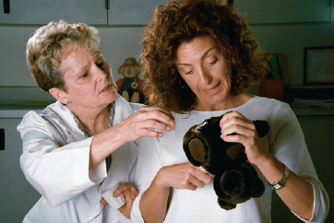
Schizophrenia
LO 14.17 Main symptoms of schizophrenia
Positive symptoms - symptoms of schizophrenia that are excesses of behavior or occur in addition to normal behavior; hallucinations, delusions, and distorted thinking.
  Delusions - false beliefs held by a person who refuses to accept evidence of their falseness.
    Delusional disorder - a psychotic disorder in which the primary symptom is one or more delusions (may or may not be schizophrenia).
  Hallucinations - false sensory perceptions, such as hearing voices that do not really exist.
Menu

Slide 39
Schizophrenia
LO 14.17 Main symptoms of schizophrenia
Negative symptoms - symptoms of schizophrenia that are less than normal behavior or an absence of normal behavior; poor attention, flat affect, and poor speech production.
  Flat affect - a lack of emotional responsiveness.
Menu

Slide 40
Types of Schizophrenia
LO 14.18 Types of schizophrenia
Disorganized - type of schizophrenia in which behavior is bizarre and childish and thinking, speech, and motor actions are very disordered.
Catatonic - type of schizophrenia in which the person experiences periods of statue-like immobility mixed with occasional bursts of energetic, frantic movement and talking.
Paranoid - type of schizophrenia in which the person suffers from delusions of persecution, grandeur, and jealousy, together with hallucinations.
Menu

Slide 41
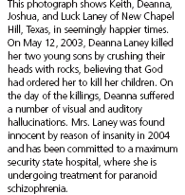
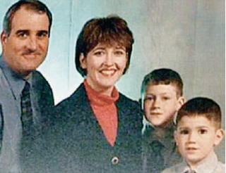
LO 14.15 Types of schizophrenia
Menu

Slide 42
Types of Schizophrenia
LO 14.18 Types of schizophrenia
Undifferentiated - type of schizophrenia in which the person shows no particular pattern, shifting from one pattern to another, and cannot be neatly classified as disorganized, paranoid, or catatonic.
Residual - type of schizophrenia in which there are no delusions and hallucinations, but the person still experiences negative thoughts, poor language skills, and odd behavior.
Menu

Slide 43
Causes of Schizophrenia
LO 14.19 Causes of schizophrenia
Psychoanalytic theories see schizophrenia as resulting from a severe breakdown of the ego, which has become overwhelmed by the demands of the id and results in childish, infantile behavior.
Behaviorists focus on how reinforcement, observational learning, and shaping affect the development of the behavioral symptoms of schizophrenia.
Cognitive theorists see schizophrenia as severely irrational thinking.
Menu

Slide 44
Causes of Schizophrenia
LO 14.19 Causes of schizophrenia
Biological explanations focus on dopamine, structural defects in the brain, and genetic influences in schizophrenia.
Stress-vulnerability model - explanation of disorder that assumes a biological sensitivity, or vulnerability, to a certain disorder will develop under the right conditions of environmental or emotional stress.
Menu

Slide 45
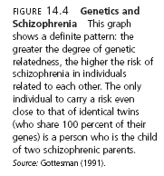
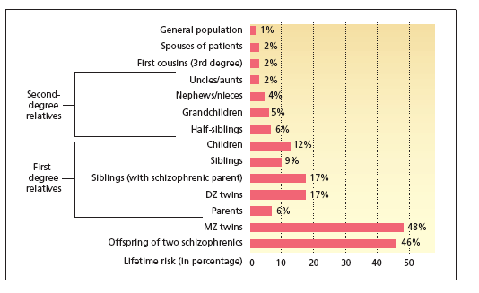
LO 14.19 Causes of schizophrenia
Menu

Slide 46
Personality Disorders
LO 14.20 Types of personality disorders
Personality disorders - disorders in which a person adopts a persistent, rigid, and maladaptive pattern of behavior that interferes with normal social interactions.
  Antisocial personality disorder - disorder in which a person has no morals or conscience and often behaves in an impulsive manner without regard for the consequences of that behavior.
  Borderline personality disorder - maladaptive personality pattern in which the person is moody, unstable, lacks a clear sense of identity, and often clings to others.
Menu

Slide 47
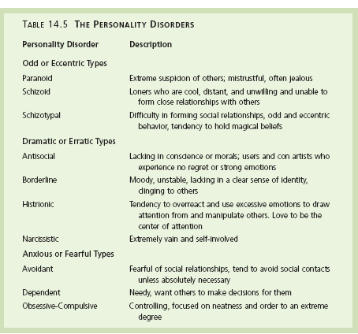
LO 14.20 Types of personality disorders
Menu

Slide 48
Causes of Personality Disorders
LO 14.21 Causes of personality disorders
Psychoanalysts blame an inadequate resolution to the Oedipal complex for personality disorders, stating that this results in a poorly developed superego.
Cognitive-learning theorists see personality disorders as a set of learned behavior that has become maladaptive—bad habits learned early on in life. Belief systems of the personality disordered person are seen as illogical.
Menu

Slide 49
Causes of Personality Disorders
LO 14.21 Causes of personality disorders
Biological explanations look at the lower than normal stress hormones in antisocial personality disordered persons as responsible for their low responsiveness to threatening stimuli.
Other possible causes of personality disorders may include disturbances in family communications and relationships, childhood abuse, neglect, overly strict parenting, overprotective parenting, and parental rejection.
Menu

Slide 50
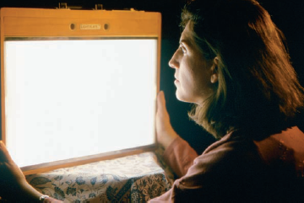
Seasonal Affective Disorder
LO 14.22 Seasonal affective disorder
Seasonal affective disorder (SAD) - a mood disorder caused by the body’s reaction to low levels of sunlight in the winter months.
Phototherapy - the use of lights to treat seasonal affective disorder or other disorders.
Menu

Slide 51
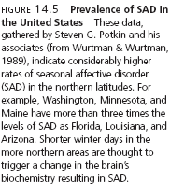
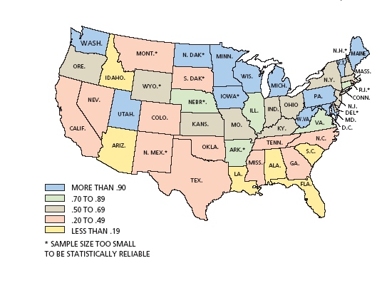
LO 14.22 Seasonal affective disorder
Menu

